Slide 1
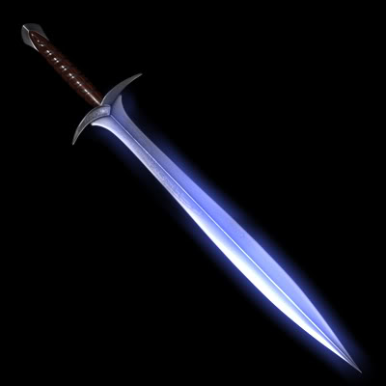
Omega Blade
Team 2 “Swordsmiths”
Austin Allen
Christian Coffield
Derrian Glynn
Brandon Hogue
Ben Jespersen(LE)
Blake Schlesinger(PM)

Slide 2
The Story

Slide 3
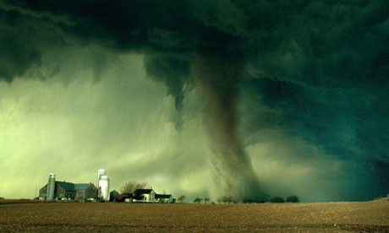
α

Slide 4

β

Slide 5

Δ

Slide 6

γ

Slide 7
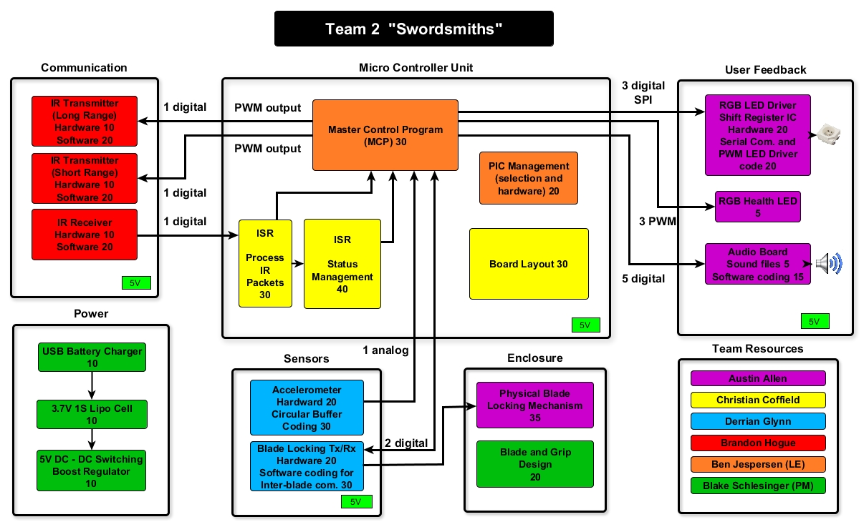

Slide 8
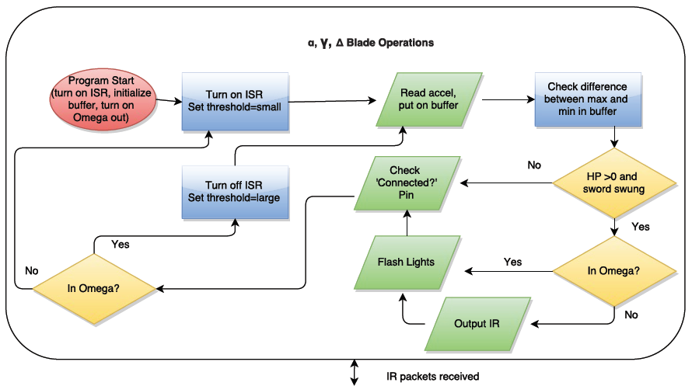
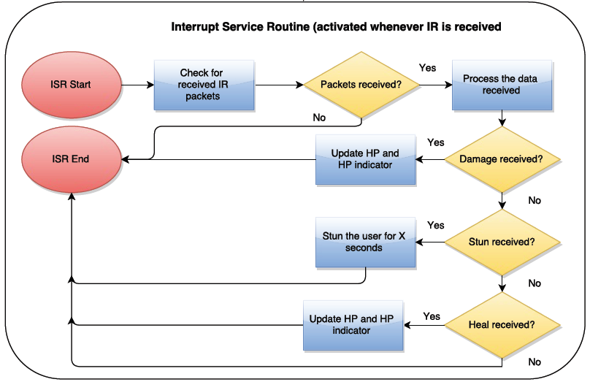

Slide 9
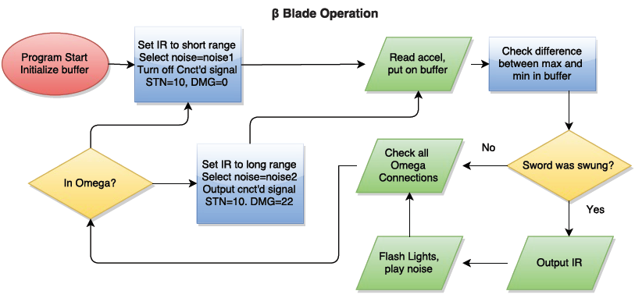

Slide 10
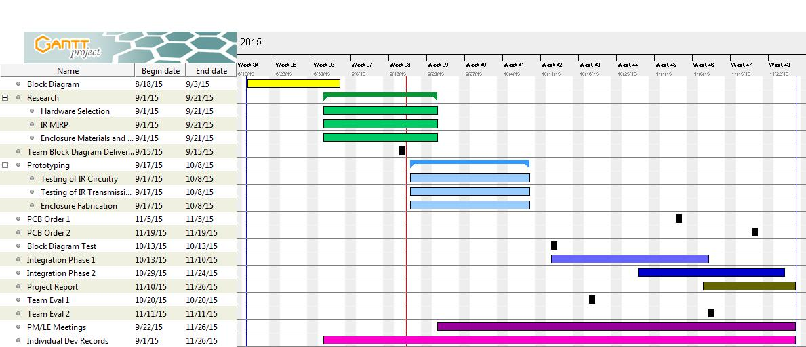
Gantt Chart

Slide 11
Questions?

